Slide 1

YouTube Cache
BY: -
ANIMESH SAHU – LCS2021035
ADITYA YADAV – LCS2021034
RAUSHAN KUMAR – LCS2021032
MANI RAJ GUPTA - LCS2021037

Slide 2

Problems??
Video buffering or low-quality video at YouTube due to slow or exhausted internet connection.

Slide 3
Our Motivation?
Slow internet in some regions
Fast internet but only for limited amount of time.
Video is hard to organize and find after local downloading. Moreover, it's hard to maintain the size of downloads.

Slide 4

TENTATIVE SOLUTION
A chrome extension for caching YouTube videos for watching it later

Slide 5
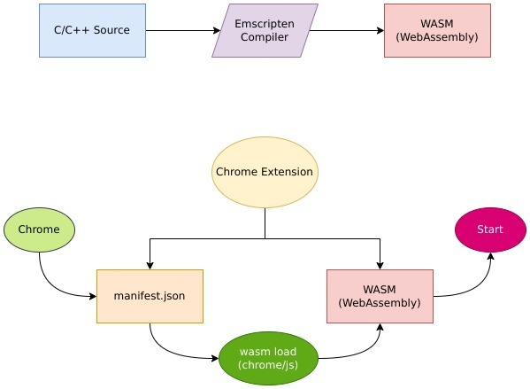
PROCESS: -

Slide 6
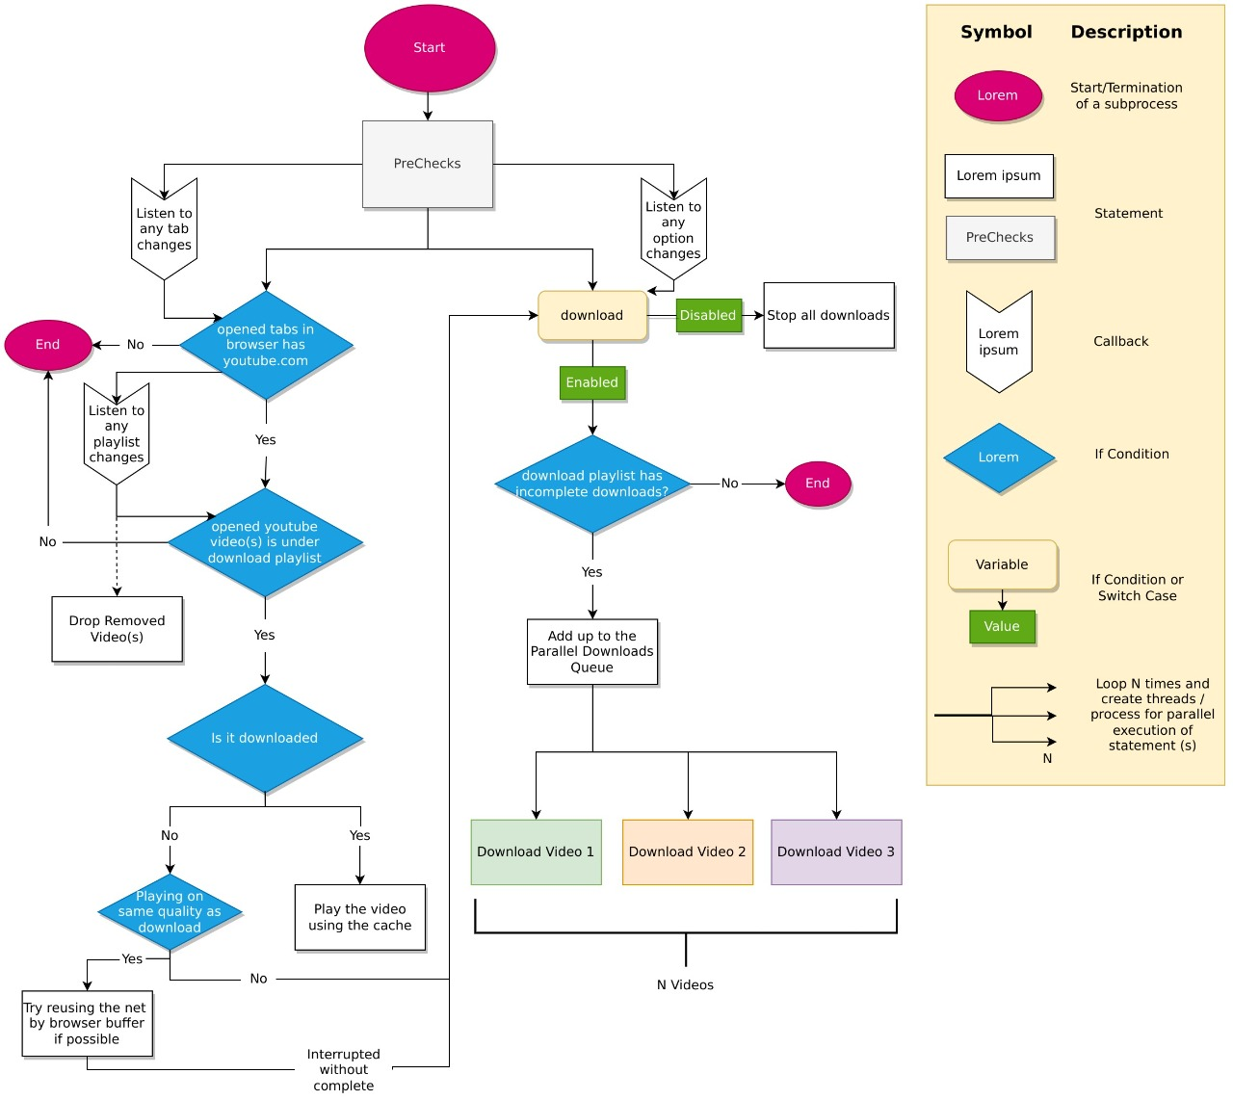
C
H
A
R
T
F
L
O
W

Slide 7
Thank you

